Slide 1


NJ Energy and Water Benchmarking
NJ Board of Public Utilities
December 13, 2022

Slide 2
Guiding Authority
Clean Energy Act
  “No later than five years after the date of enactment of P.L.2018, c.17 (C.48:3-87.8 et al.) [by May 23, 2023], the board shall require the owner or operator of each commercial building over 25,000 square feet in the State to benchmark energy and water use for the prior calendar year [2022] using the United States Environmental Protection Agency’s Portfolio Manager tool.”

Slide 3
What is Benchmarking?
The first step to saving energy at your building is to benchmark — that is, to measure and compare your building’s energy to similar buildings, past consumption, or a reference performance level.
Benchmarking turns the information on your utility bill into knowledge you can act on.

Slide 4
Benefits of Benchmarking
Identify underperforming buildings to target for efficiency improvements
Identify best practices from efficient buildings
Set investment priorities
Verify savings and prevent snapback
Share and report performance
Earn recognition with Energy Star Certification
Benchmark more than energy (such as water use, waste and materials, and greenhouse gas emissions)
Implement a comprehensive management program

Slide 5
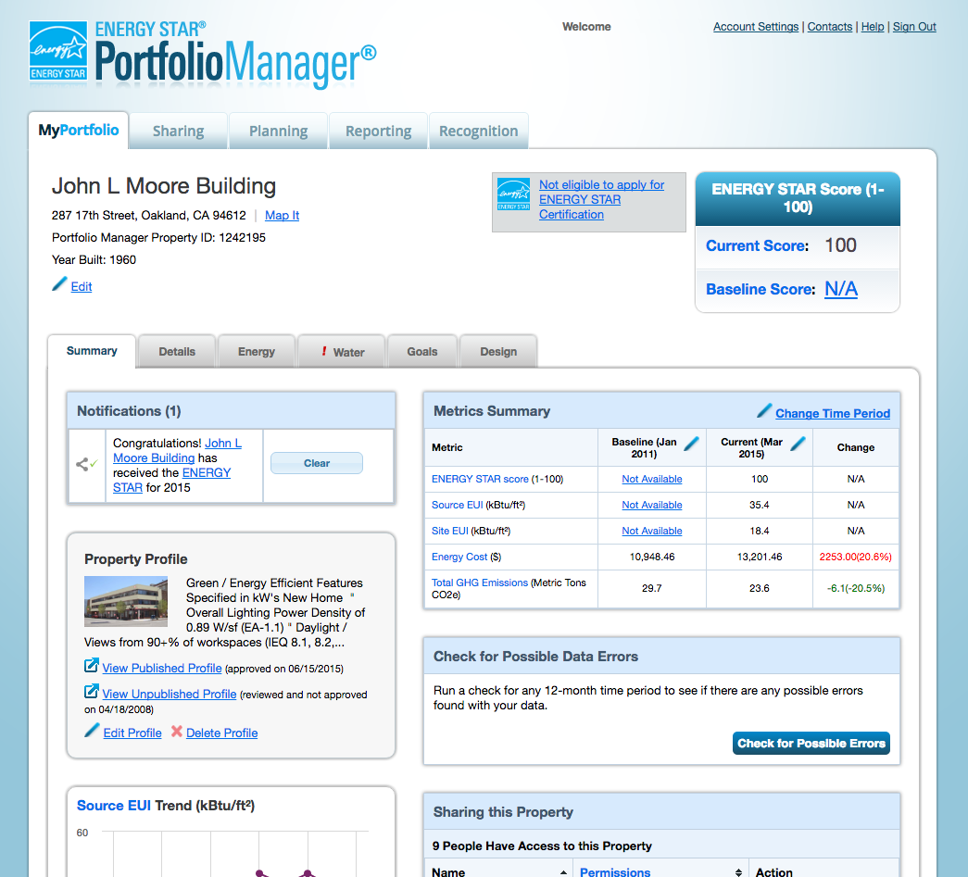
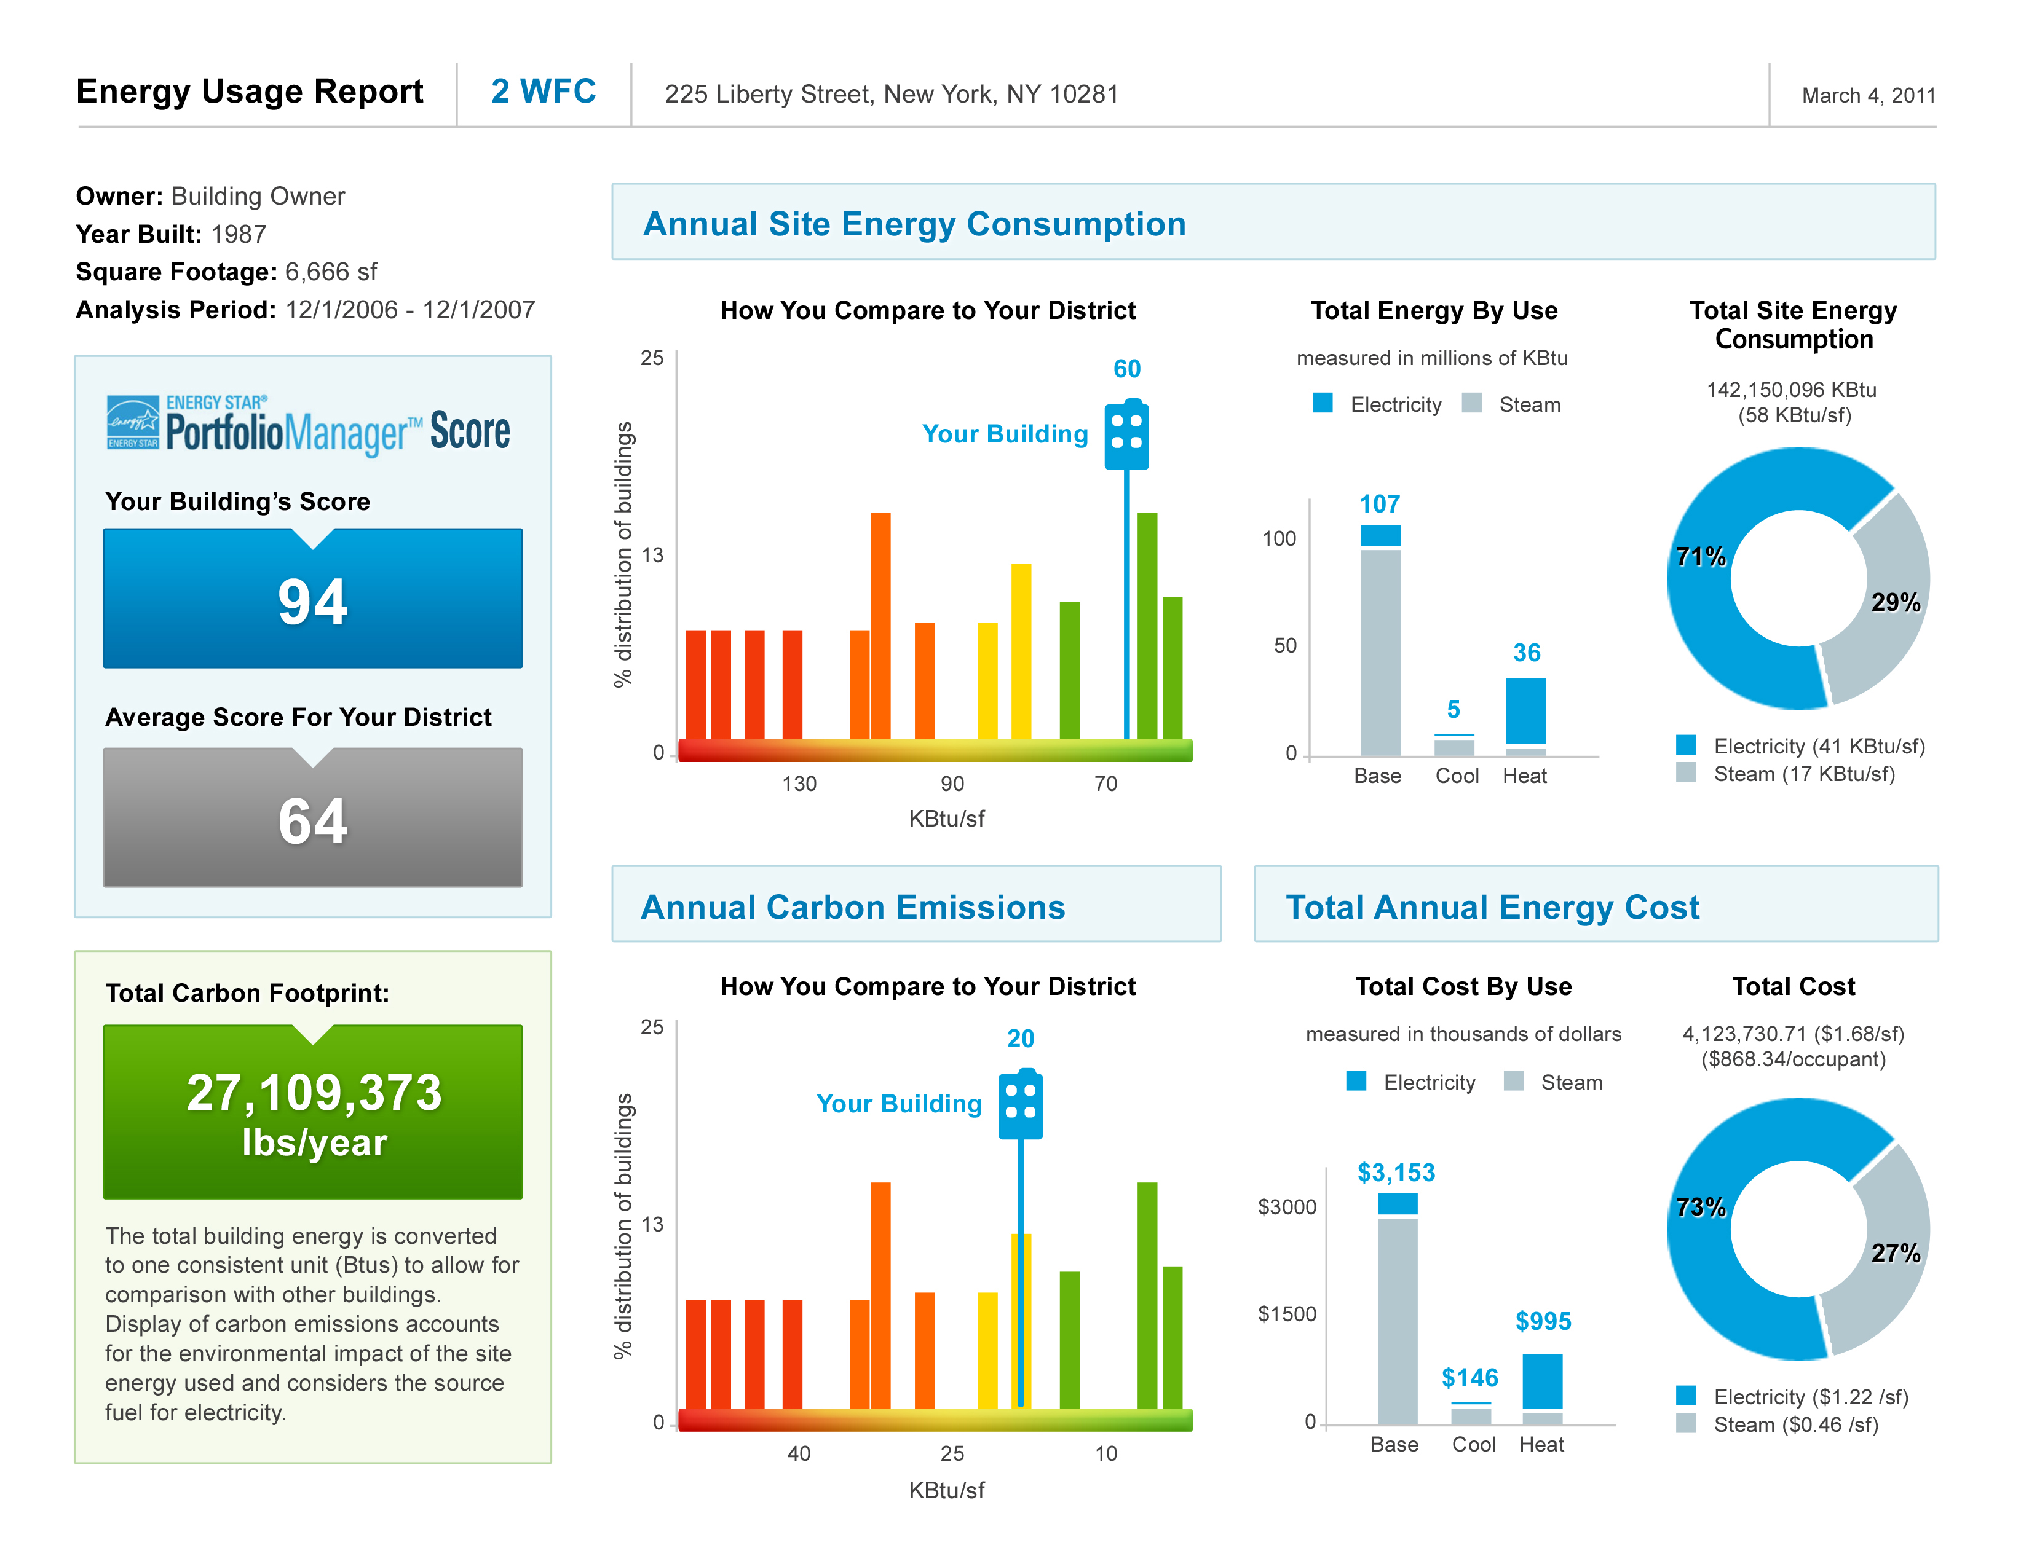
What is Energy Star Portfolio Manager?
Input building characteristics and monthly energy & water use
Output Report shows benchmarks against EPA’s national database of buildings

Slide 6
How to Benchmark
Getting Started
Receive benchmark notification from BPU with a unique building ID (UBID*)
Enter property information into Portfolio Manager
Enter Utility Data
Enter data manually, or
Results
Portfolio Manager has QA checks for input values and output results
Data is shared with BPU
Decide to request an exemption
BPU has a help desk to assist with Portfolio Manager
Request data from utility
Assign responsibility – self, staff, or NJ Certified Benchmarker
Receive benchmarking report
* UBID is a building identification standard developed by US-DOE that is based latitude, longitude, and building footprint.
Notes:
We will have a how-to-guide available

Slide 7
You may request an exemption
Demolition – Demolished or soon-to-be demolished buildings
Unoccupied – A building is unoccupied for a full year (365 days)
Foreclosure or Bankruptcy – An action for foreclosure or bankruptcy has been filed during a particular reporting year
Other Conditions – Certain other situations for good cause may be exempted (e.g., inaccuracy in the Covered Buildings list)
Notes:
BPU Staff will determine if the exemption is indefinite or only for one year.

Slide 8
Requesting aggregated building-level data from a regulated utility
Complete form on utility’s benchmark-ing webpage
Utility matches customers to the building
Owner confirms list of customers represents the building
Utility checks the consumer protection (4/50) rule
Utility sends aggregated data*
* Depending on the utility, the data is sent directly to your Portfolio Manager account or to you on a spreadsheet, which you then upload to Portfolio Manager

Slide 9
Consumer Protection aka 4/50 Rule
The regulated utility will automatically aggregate the customer data for the building if,
  There are four or more customers, and
  No one customer exceeds 50% of the usage
If the 4/50 rule is not satisfied, then you will have to get consent from individual tenants to release their data. Blank consent letters will be available from the utility
  The utility will only aggregate data from consenting tenants

Slide 10
Requesting aggregated building-level data from a non-regulated utility
If the utility offers data aggregation,
  Then follow a process similar to the regulated utilities
If the utility does not offer data aggregation,
  Download a consent letter from BPU’s benchmarking website
  Get consent from each tenant and return the consent letter to the utility
  The utility will send the individual customer’s data, but you will have to aggregate the data and upload it to Portfolio Manager

Slide 11

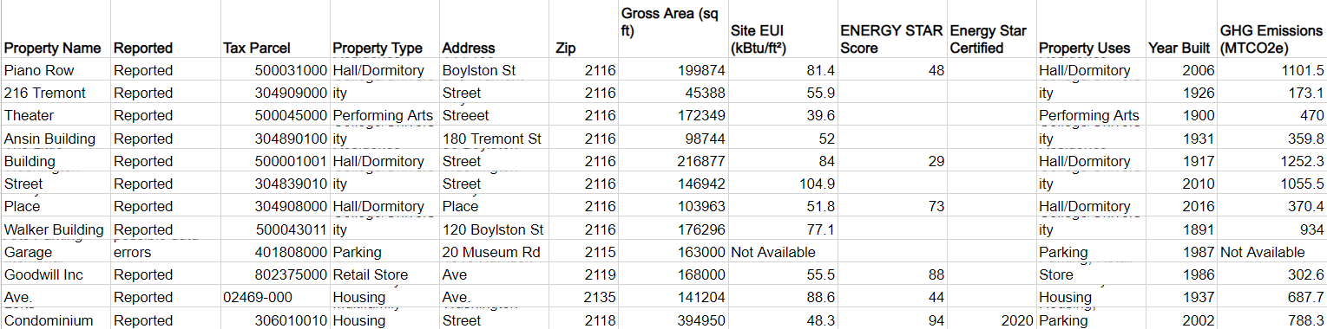
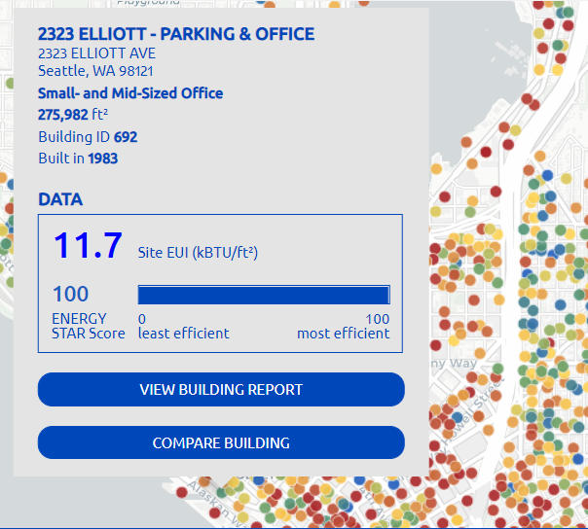
Public Reporting Format is TBD
Public Database
(e.g., Boston)
Program Impact Report
(e.g., Chicago)
Searchable Map
(e.g., Seattle)
Notes:
Sign up for listserv to participate in the public hearing

Slide 12
Timeline
Notifications Sent
~July 1 2023
Data Access Service available
Aug 1, 2023
First Submission
Oct 1, 2023
Notes:
“How to guide” to be published in 2Q.

Slide 13
Questions?
Learn more at https://njcleanenergy.com/commercial-industrial/programs/cea-benchmarking

